Slide 1
Dependency Injection Reflection Annotations

Slide 2
Dependency Injection
Java Dependency Injection design pattern allows us to remove the hard-coded dependencies and make our application loosely coupled, extendable and maintainable.

Slide 3
What is dependency injection?
Dependency injection is a concept valid for any programming language.
The general concept behind dependency injection is called Inversion of Control:
According to this concept a class should not configure its dependencies statically but should be configured from the outside.
A Java class has dependency on another class, if it uses an instance of this class.
If the Java class creates an instance of another class via the new operator, it cannot be used (and tested) independently from this class and this is called a hard dependency.

Slide 4
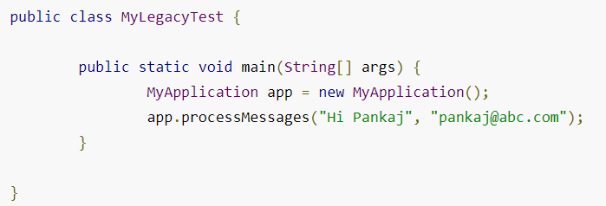
Example of Hard Dependency. Approach 1 – hard code the creation (new)
public class EmailService {
public void sendEmail(String message, String receiver){
System.out.println("Email sent to "+receiver+ " with Message="+message);
}
}
public class MyApplication {
private EmailService email = new EmailService();
public void processMessages(String msg, String rec){
this.email.sendEmail(msg, rec);
}
}

Slide 5
Approach 2 – Pass an instance to the constructor
public class MyApplication {
private EmailService email = null;
public MyApplication(EmailService svc) { this.email=svc; }
public void processMessages(String msg, String rec){
this.email.sendEmail(msg, rec);
}
}
Inversion of Control:
client applications or test classes to initializing the email service that is not a good design decision.

Slide 6
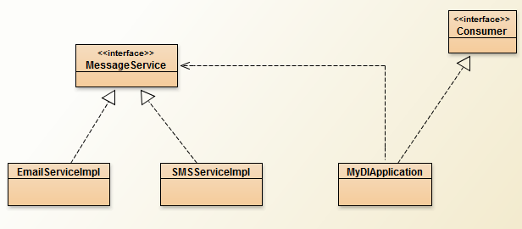
Java Dependency Injection – Service Components
Go to Blue-J DependencyInjection-Step0

Slide 7
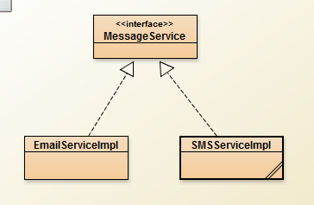
DEPENDENCY INJECTION PATTERN
java dependency injection pattern to solve all the problems with above implementation. Dependency Injection in java requires at least following:
Service components should be designed with base class or interface. It’s better to prefer interfaces or abstract classes that would define contract for the services.
Consumer classes should be written in terms of service interface.
Injector classes that will initialize the services and then the consumer classes.

Slide 8
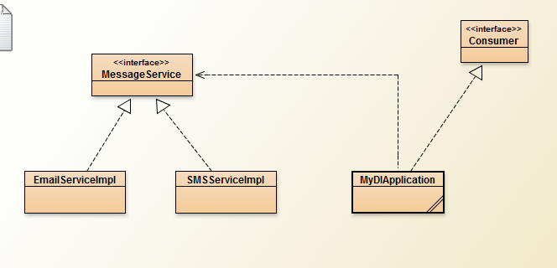
Java Dependency Injection – Service Consumer
Go to BlueJ DependencyInjection2 Demo

Slide 9
What's wrong with previous implementation?
Hard-coded dependency.
MyApplication class is responsible to initialize the email service and then use it.
Not extendible (can’t support a newer email msgs: SMS or Facebook!)
Construction by hand (new)
we can remove the email service instance creation from MyApplication class by having a constructor that requires email service as argument.
Construction by hand (Construction Injection) - See example DI2
Use @inject use Context Dependency Injection ( Injector )

Slide 10
Where can objects be injected into a class according to JSR330?
Dependency injection can be performed on (in that ORDER):
the constructor of the class (construction injection)
a field (field injection)
the parameters of a method (method injection)
The @Inject annotation is used to mark where an injection goes. You can annotate constructor arguments, instance fields and setter methods of properties.

Slide 12
Java Dependency Injection – Injectors Classes
The previous example is taking from this link:
https://www.journaldev.com/2394/java-dependency-injection-design-pattern-example-tutorial
Programming Assignment #3: complete the Injector Classes and build the complete project (submit a complete application)

Slide 13
Java Annotations
Java Annotations allow us to add metadata information into our source code, although they are not a part of the program itself.
Annotations were added to the java from JDK 5.
Annotation has no direct effect on the operation of the code they annotate

Slide 14
Java Annotations
Java Annotation is metadata about the program embedded in the program itself. It can be parsed by the annotation parsing tool or by compiler.
We can also specify annotation availability to either compile time only or till runtime also.
Before java annotations, program metadata was available through java comments or by Javadoc

Slide 15
What’s the use of Annotations?
Instructions to the compiler:
BUILD-IN : (@Deprecated, @Override & @SuppressWarnings)
Compile-time instructors: Annotations can provide compile-time instructions to the compiler that can be further used by software build tools for generating code, XML files etc.
Runtime instructions: We can define annotations to be available at runtime which we can access using java reflection and can be used to give instructions to the program at runtime

Slide 16
Built-in annotations in Java 1) Instructions to the compiler:
@Override – When we want to override a method of Superclass, So when superclass method is removed or changed, compiler will show error message.
@Deprecated – when we want the compiler to know that a method is deprecated, we should use this annotation
@SuppressWarnings – This is just to tell compiler to ignore specific warnings they produce, for example using raw types in java generics. It’s retention policy is SOURCE and it gets discarded by compiler.

Slide 17
Java @Override annotation
Demo Justification

Slide 18
Java Custom Annotation
import java.lang.annotation.Documented;
import java.lang.annotation.ElementType;
import java.lang.annotation.Inherited;
import java.lang.annotation.Retention;
import java.lang.annotation.RetentionPolicy;
import java.lang.annotation.Target;
@Documented
@Target(ElementType.METHOD)
@Inherited
@Retention(RetentionPolicy.RUNTIME)
public @interface MethodInfo {
String author() default "Aldawud";
String date();
int revision() default 1;
String comments();
}
Annotations are created by using @interface,
Creating custom annotation in java is similar to writing an interface, except that it interface keyword is prefixed with @ symbol.
All annotations extends java.lang.annotation.Annotation interface.
Annotations cannot include any extends clause.
Annotation methods can’t have parameters.
Annotation methods return types are limited to primitives, String, Enums, Annotation or array of these.
Java Annotation methods can have default values.
Annotations can have meta annotations attached to them. Meta annotations are used to provide information about the annotation.

Slide 19
Custom Annotations
@Documented @Target(ElementType.METHOD)
@Inherited @Retention(RetentionPolicy.RUNTIME)
public @interface MyCustomAnnotation{
int studentAge() default 18;
String studentName();
String stuAddress();
String stuStream() default "CS";
}
@MyCustomAnnotation (
studentName=“Tom", stuAddress=“Aldawud, Japan"
)
public class MyClass {
…
}
@Documented
@Documented annotation indicates that elements using this annotation should be documented by JavaDoc.
@Target
It specifies where we can use the annotation.
@Inherited
The @Inherited annotation signals that a custom annotation used in a class should be inherited by all of its sub classes.
@Retention
It indicates how long annotations with the annotated type are to be retained.

Slide 20
Java Reflection
Reflection API is very powerful and used widely in Java, J2EE frameworks like Spring, Hibernate, JUnit, check out Reflection in Java.

Slide 21
Reflection in Java
Java Reflection provides ability to inspect and modify the runtime behavior of application.
Reflection in Java is one of the advance topic of core java.
Using java reflection we can inspect a class, interface, enum, get their structure, methods and fields information at runtime even though class is not accessible at compile time.
We can also use reflection to instantiate an object, invoke it’s methods, change field values.

Slide 22
Reflection in Java
Reflection in Java is a very powerful concept and it’s of little use in normal programming but it’s the backbone for most of the Java, J2EE frameworks. Some of the frameworks that use java reflection are:
JUnit – uses reflection to parse @Test annotation to get the test methods and then invoke it.
Spring – dependency injection, read more at Spring Dependency Injection
Tomcat web container to forward the request to correct module by parsing their web.xml files and request URI.
Eclipse auto completion of method names
Struts
Hibernate
Why Reflection?
all frameworks above use java reflection because all these frameworks have no knowledge and access of user defined classes, interfaces, their methods etc.

Slide 23
Reflection in Java - Drawbacks
Poor Performance – Since java reflection resolve the types dynamically, it involves processing like scanning the classpath to find the class to load, causing slow performance.
Security Restrictions – Reflection requires runtime permissions that might not be available for system running under security manager. This can cause you application to fail at runtime because of security manager.
Security Issues – Using reflection we can access part of code that we are not supposed to access, for example we can access private fields of a class and change it’s value. This can be a serious security threat and cause your application to behave abnormally.
High Maintenance – Reflection code is hard to understand and debug, also any issues with the code can’t be found at compile time because the classes might not be available, making it less flexible and hard to maintain.

Slide 24
Code - java.lang.Class
java.lang.Class is the entry point for all the reflection operations.
For every type of object, JVM instantiates an immutable instance of java.lang.Class that provides methods to examine the runtime properties of the object and create new objects, invoke its method and get/set object fields.
concreteClass = new ConcreteClass(5).getClass();
concreteClass.getCanonicalName();
Class.forName(“edu.itm515.ConcreteClass").getSuperclass();

Slide 25
Demo

